Slide 1
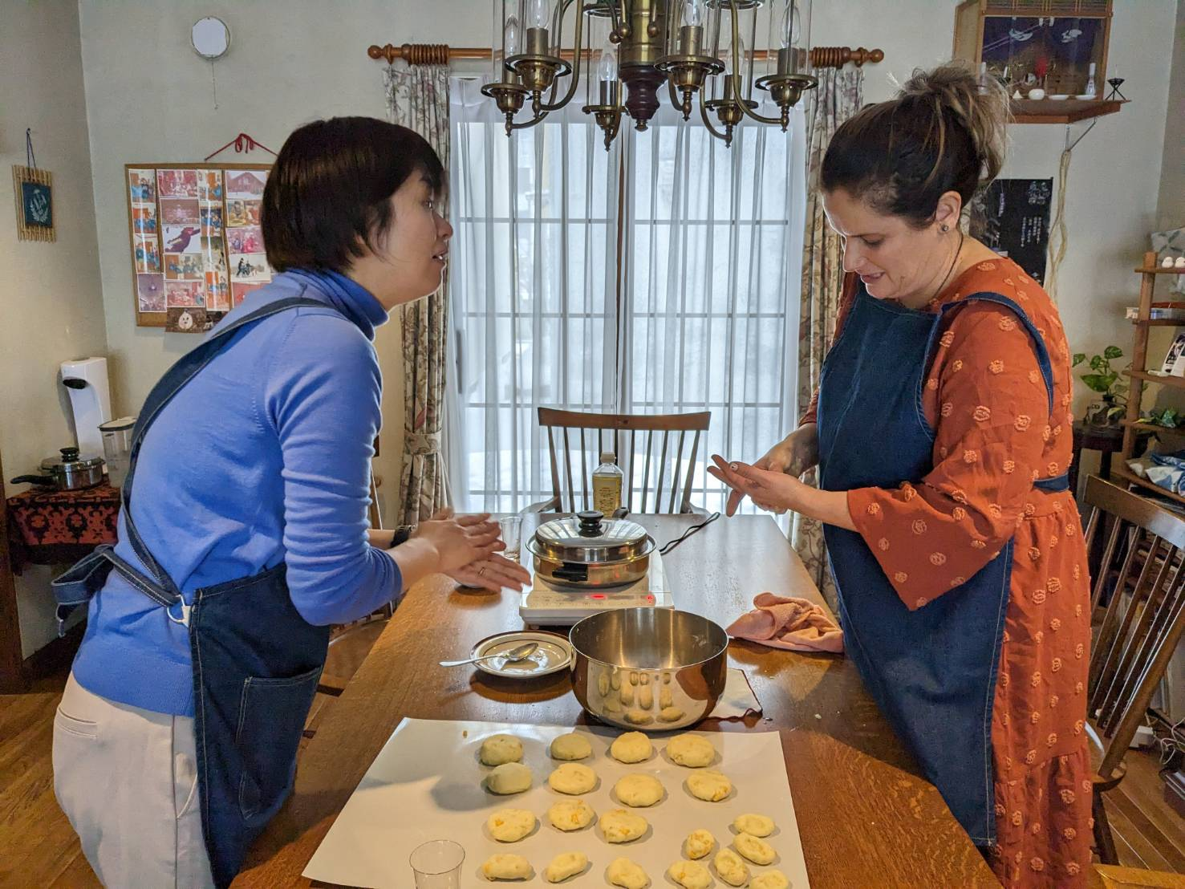
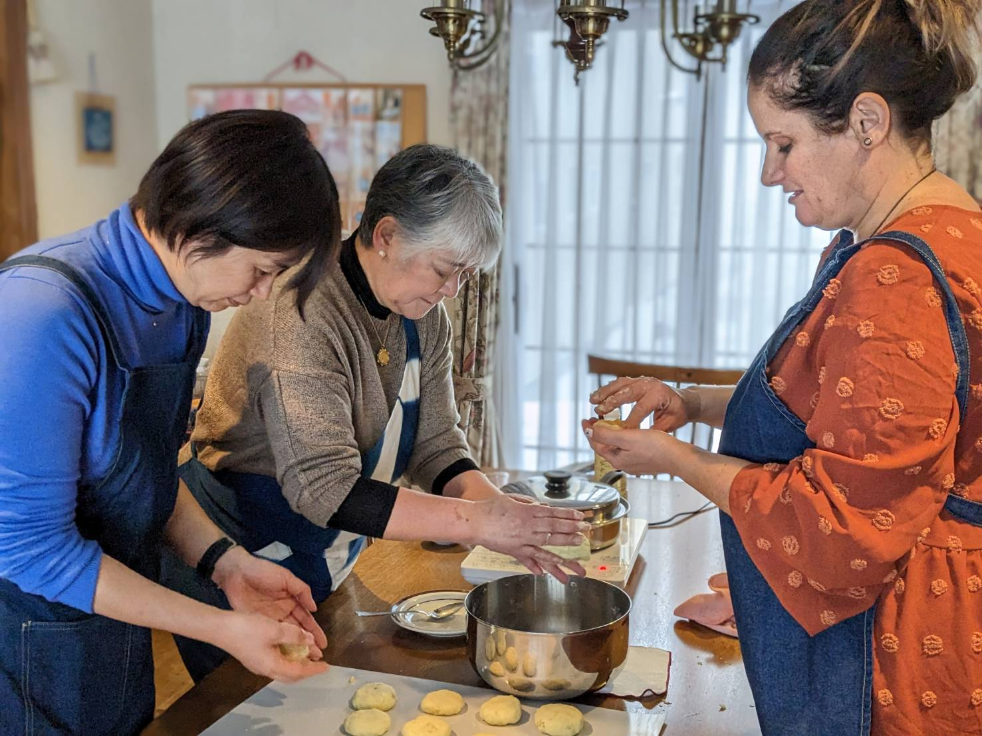
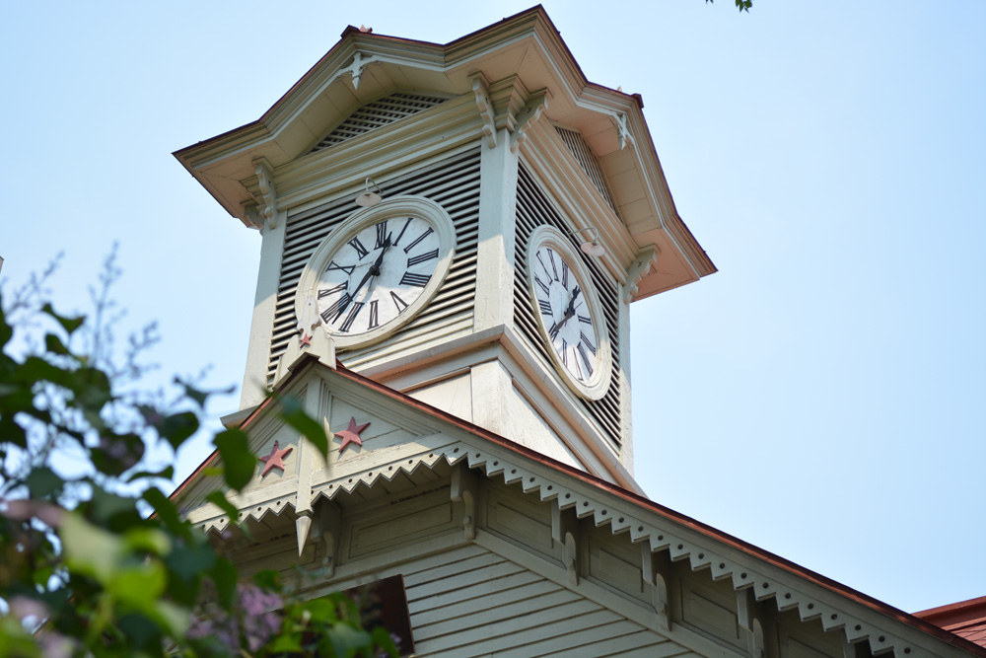
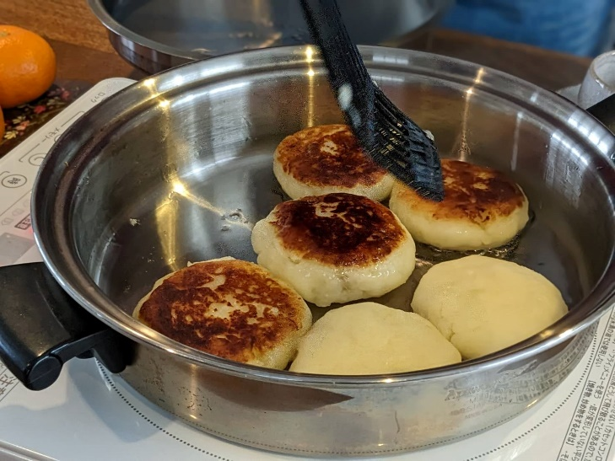
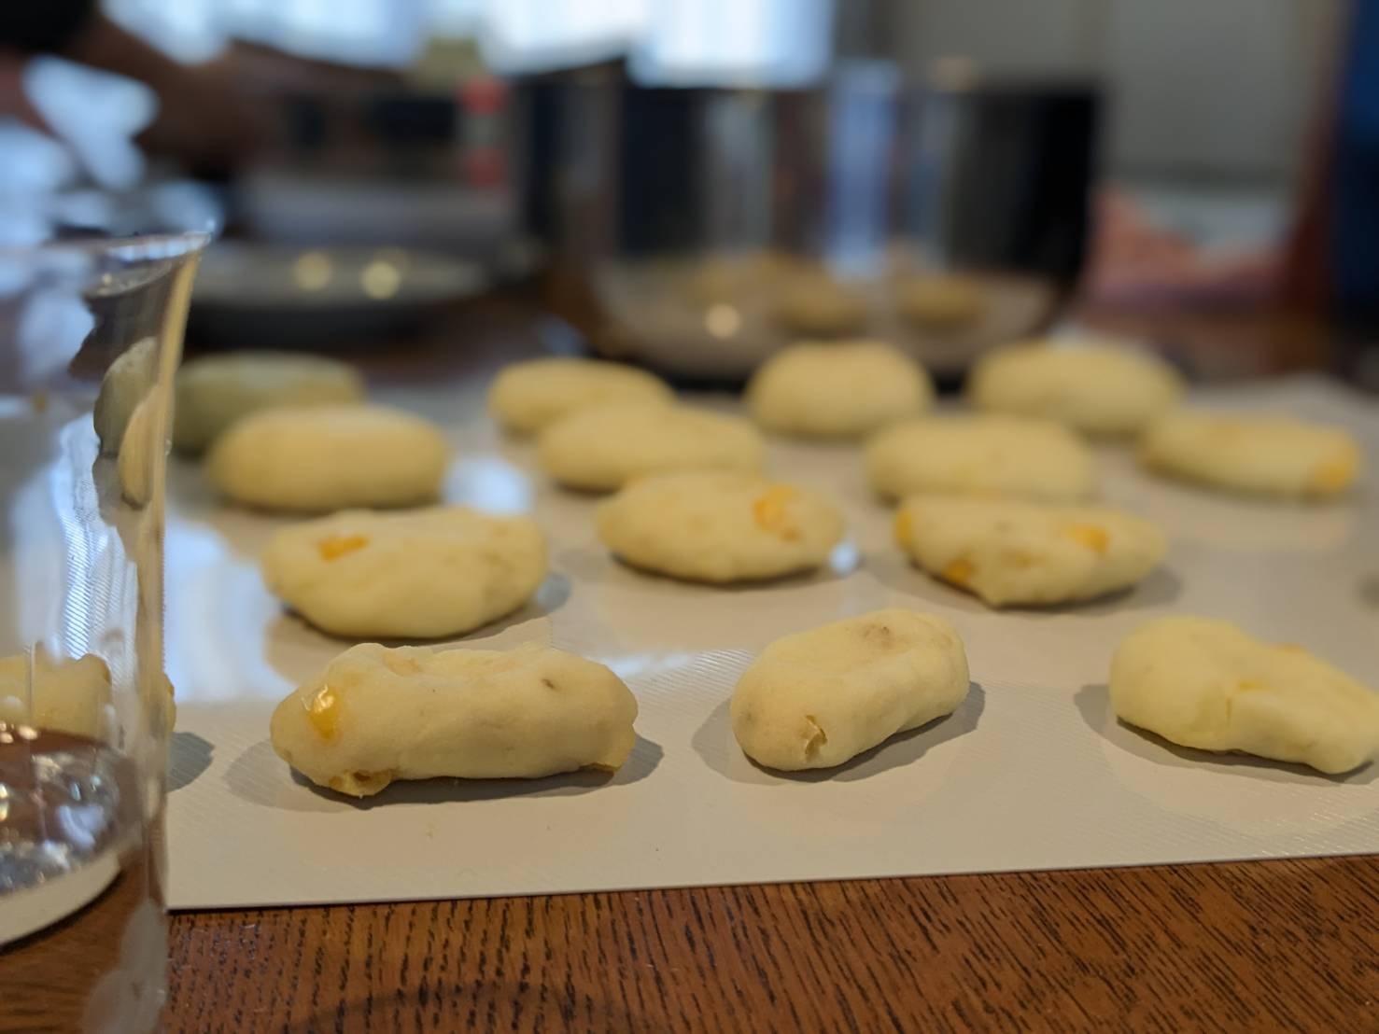
Sapporo Walking Tour – Get to Know Our Unique City and Enjoy Cross-Cultural Experiences with Locals!
イメージ画像
3～4枚程度（解像度は問わない）
※この場所でなくても、イメージ画像は随時フォームのどの場所でも効果的に挿入してください。
Our one-of-a-kind walking tour is a great way for you to experience Sapporo's history, culture and food!
Sapporo, a city of 2 million, harmonizes the urban landscape with nature. We're one of the few – if not only – cities in the world situated in a heavy snowfall area. But what kind of city is Sapporo really? How did it develop so quickly, in only 150 years?
Our walking tour gives you the answers. Dig deep into the city's lore, culture, and history, all while stopping at well-known sightseeing spots.
You'll also purchase ingredients at local supermarket, and visit a local home to make Imo Mochi (potato cake), a traditional homemade snack eaten since Hokkaido's pioneer days. You'll experience Sapporo's real daily life and enjoy meaningful cultural exchanges with locals.
・Visiting and spending time at a private home gives you a unique opportunity to share in the typical daily life of Japanese and Hokkaido people. Stimulate your intellectual curiosity via cross-cultural exchange in a cozy environment!
・Not only will you learn Sapporo's history and culture while visiting sightseeing spots, you'll also experience the local lifestyle by helping prepare food at a local home.

Slide 2
Sapporo Walking Tour – Get to Know Our Unique City and Enjoy Cross-Cultural Experiences with Locals!
Highlights:
・Learn the history and culture of the unique city of Sapporo.
・Fun cooking experience: Prepare traditional local food loved by Hokkaido people.
・Cross-cultural exchange to observe the real daily life of Hokkaido people.
・Experience authentic Hokkaido life by visiting and spending time at a private home.
・Imo Mochi (potato cake) and Kenchinjiru Soup (Japanese-style chowder) for lunch (vegan dishes.)
・Shop at a local supermarket, meeting local shoppers and exchanging small talk.
・We highly recommend taking this tour at the start of your Sapporo stay. And, since this is a single-day tour, it's easy to combine it with other Sapporo tour experiences.
・Spend a healthy day, enjoying vegan dishes and doing some light walking (Mariko Ishikawa, your guide, is an expert in intestinal health.)
Location:
Sapporo, Hokkaido
Main Activity:
Walking
Difficulty:
1
Availability:
Round year
Tour Duration:
1 Day
JPY 26,000 /per（2pax~）
JPY 13,500/per（5pax~）
JPY 9,000/per（8pax~）
Pax:
Minimum 2
Maximum 10
Price per person:
Route map
Day-by-day Itinerary
What’s included
We provide & What to bring
About us
Information and Requirements
Reservation & Cancellation policy

Slide 3
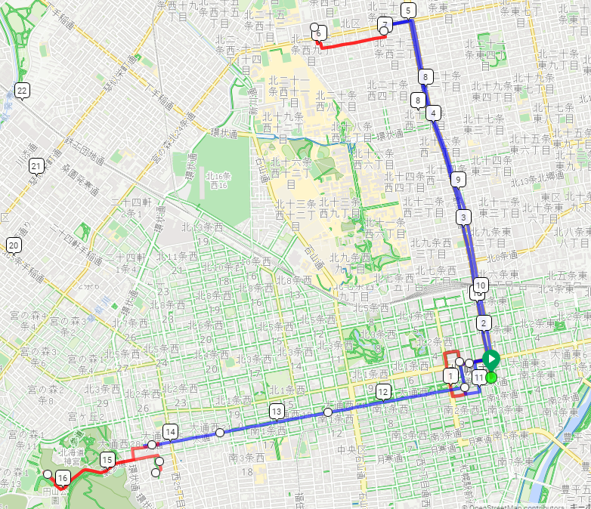
Sapporo Walking Tour – Get to Know Our Unique City and Enjoy Cross-Cultural Experiences with Locals!
Route map <DAY 1~2>
行程を示す地図
添付の例は、Google Mapの「マイマップ」機能利用
＜DAY 1＞
Red: Traveling by train
Blue: Public Transportation
Super Market
& Mariko’s house
Kita24 jyo Sta.
Sapporo Clock Tower &
Sapporo City Hall
Odori Sta.
Sapporo TV Tower
Hokkaido Shrine
Maruyama Park Sta.
Strolling Maruyama area

Slide 4
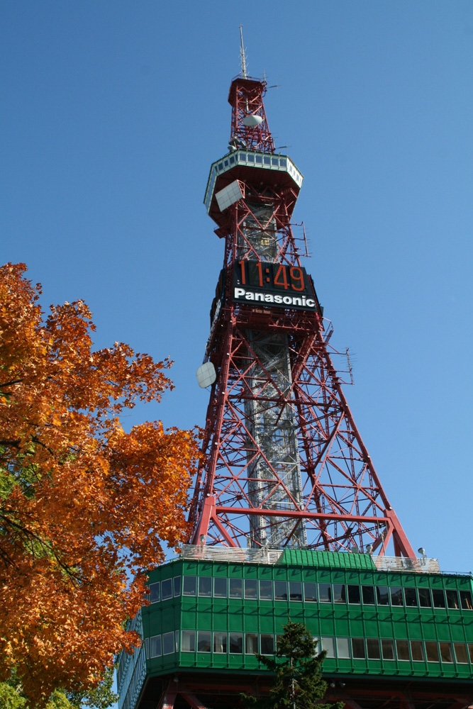
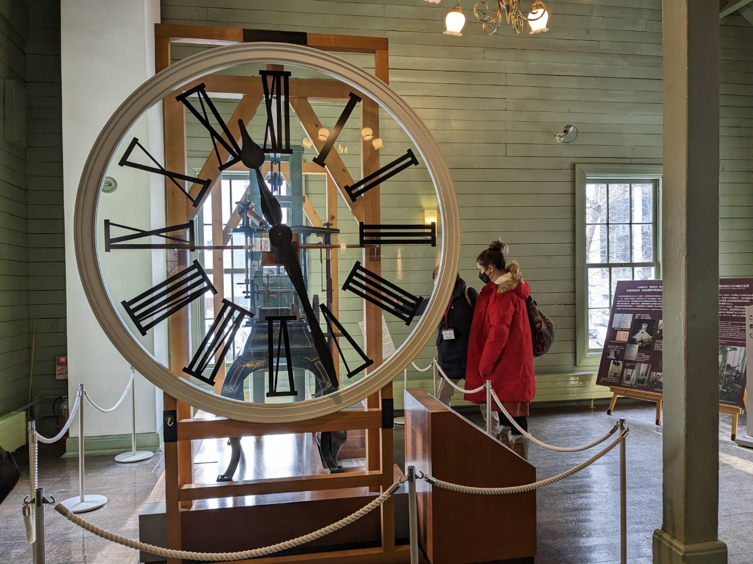
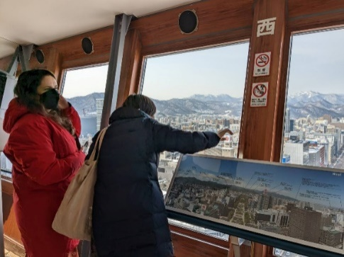
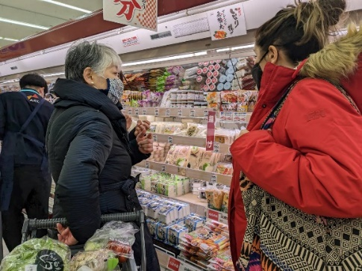
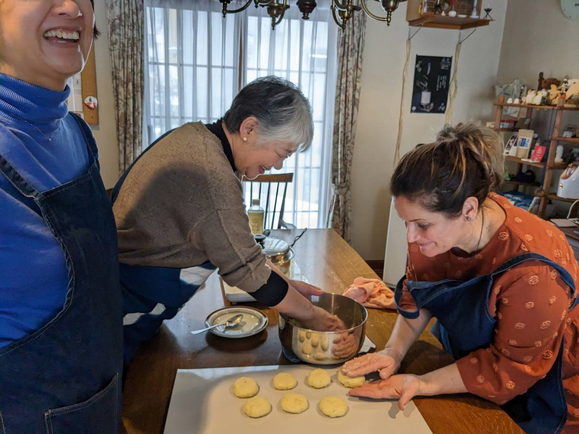
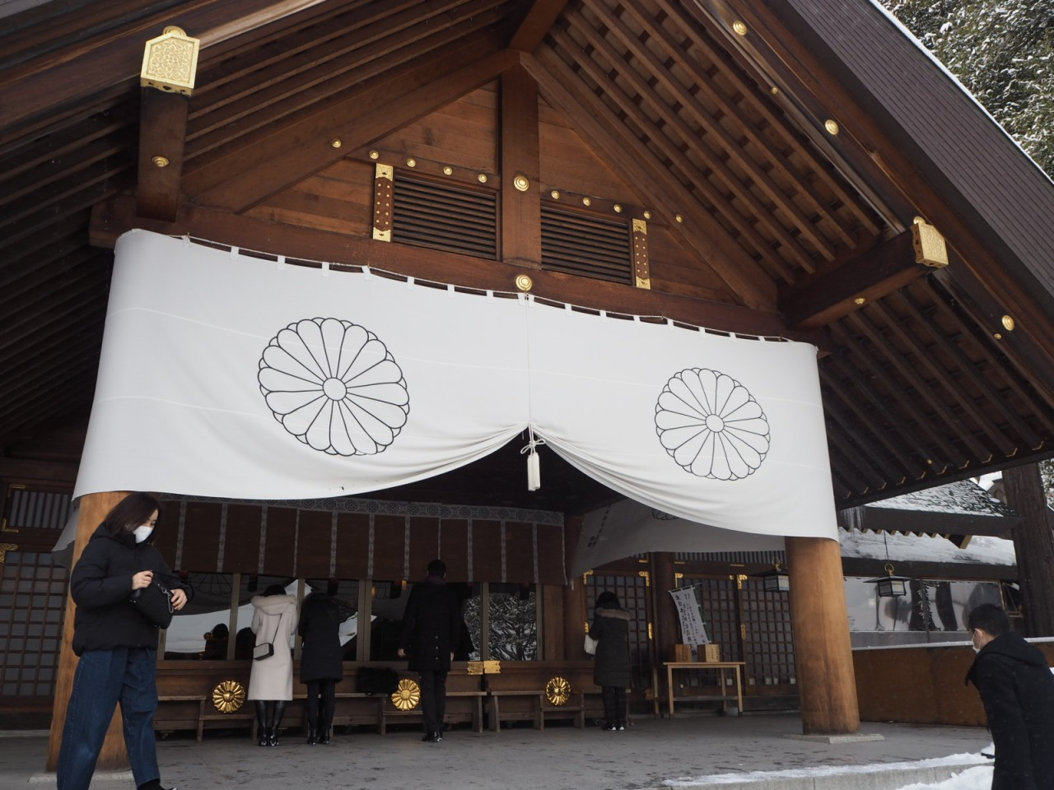
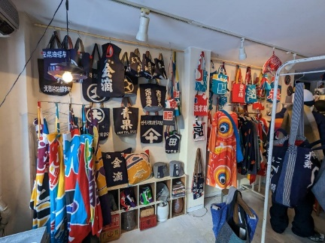
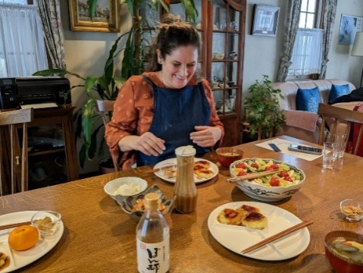
Sapporo Walking Tour – Get to Know Our Unique City and Enjoy Cross-Cultural Experiences with Locals!
Itinerary
Start from Sapporo TV Tower
Meet at Sapporo TV Tower at 9:00a.m. to start your Sapporo City tour
Enjoy a 360-degree view of Sapporo's cityscape and learn its history and sightseeing spots you will be visiting
Next, visit Sapporo City Hall and Sapporo Clock Tower to discover the city's pioneer history.
Get to know Shima Yoshitake, the passionate chief magistrate of the Hokkaido Development Commission who authored the original plans to build the city.
Even after Yoshitake-san departed Hokkaido, his plans were followed. Today his ideas, insights, and innovations are seen at every turn of the city.
Do what the locals do, by taking the municipal subway to meet Sapporo native Mariko Ishikawa, and then go grocery shopping together. After purchasing the ingredients you'll need at a local market, visit Ms. Ishikawa's home to make Imo Mochi (potato cake), one of Hokkaido's favorite snacks.
Your lunch will also feature Kenchinjiru-soup (Japanese vegetable chowder). Relax and chit-chat, and discuss different perspectives on daily life and culture, as well as learn about making cloth sandals by traditional sustainable methods, indigo dying, and intestinal health.
Imo Mochi (potato cake): In Hokkaido's early days during the Meiji Era rice wasn't grown locally, due both to cold weather and to insufficient agricultural technique. Imo Mochi became a substitute for rice cakes (mochi) and were an important energy source for pioneers. Imo Mochi also came in handy during the food shortages experienced during and after the War in the Pacific.
Kenchinjiru-soup, a type of Buddhist vegetarian meal, is a clear broth with root vegetables.
Take the subway to get to Maruyama Park, and stroll around the Hokkaido Shrine.
Guided by a forest expert, learn about the flora of the park.
Pay respects at the Hokkaido Shrine and learn about Shima Yoshitake, a samurai and Japanese government official who founded the city of Sapporo. Taste the Hangan-sama (a pastry with a sweet bean paste filling) baked here, which are named after Shima himself (his title of Hangan means a chief magistrate of the Meiji Period).
During your leisurely Maruyama stroll, visit a gift shop specializing in items made from colorful fishermen's banners, a rice cracker shop and a cafe for a coffee break.
Activity: Walking
Difficulty: 1

Slide 5
Sapporo Walking Tour – Get to Know Our Unique City and Enjoy Cross-Cultural Experiences with Locals!
We provide& What to bring
What you must bring
Pasport
Cash | *Since cards are not accepted in some places
warm clothing *winter season
changing clothes
Quick-drying innerwear and layered clothing.
Sunglasses | *when hiking up
knitted hat *winter season
Gloves *winter season
Down jacket *winter season | (compact and put in your backpack and wear over the jacket when it is cold. with hood), down jacket
Water, Thermos water bottle (about 500 ml to 1 liter that can be kept warm)
Chargers for smartphones
Masks
Back pack
Things that are more convenient to have
Handkerchiefs and pocket tissues
"Medicine to prevent sickness.
Sunscreen
spare smart phone battery
first aid kit
What we provide
Admission fee and activity fee are included. *Does not include personal souvenirs, food and beverages.
□＝Necessary / △＝Recommended
□Regular warm clothing □Hat・cap
□Gloves
□bathing suit
□Bath Towel
□ Extreme cold weather winter wear (such as ski clothes), warm waterproof winter shoes □ Personal toiletries
□Personal toiletries
□My Bottle, My Cup, My Chopsticks, etc.
△Camera and smart phone
△Disposable heating pads

Slide 6
Sapporo Walking Tour – Get to Know Our Unique City and Enjoy Cross-Cultural Experiences with Locals!
About us
The company is certified by JATA’s Tour Quality Japan Quality Assurance System for Tour Operators. Our mission is to provide the highest quality services to our clients. We specialize in Japan inbound tours focusing on Hokkaido.
・ATTA Members
・Website for B2B https://www.dmcjapan-knt.com/
Guides
＜Guide for the entire tour: Chie Moue＞
English Instructor, National Government Licensed Guide Interpreter, Forest Instructor, Service Industry English Advisor, Wilderness Advanced First Aid (WAFA), Certified Trainer “Leave No Trace”
Born in 1973 in Fukushima, currently resides in Sapporo. After studies in Forestry and Forest Environmental Education at the Hokkaido Regional Forest Office, learned English teaching methods in Australia. Established “M's English” after working as an English teacher and English Nature Guide in Shiretoko. 16 years of experience as an English instructor, and 14 years as a National Government Licensed Guide Interpreter. Presently conducts various seminars and lectures for the service industry, English guides, and the adventure travel and forest industries.
＜Local Guide: Mariko Ishikawa＞
Born and raised in Sapporo. Cooking instructor specializing in intestinal health (Food Hygiene Manager), Indigo Dye instructor
Self-studied traditional indigo dye processes in her 60's; currently promoting sustainable indigo dye processes in Hokkaido with fellow indigo scholar Etsuko Kameda. Further sustainability activities via the promotion of recycling/reusing old kimono in daily life, including the creation of small articles from kimono and indigo cloth for use in promotional activites.
Has made her own miso paste for more than 30 years. Holds cooking classes at home, using fermented food to enhance intestinal health.
Guides
＜Guide for the entire tour: Chie Moue＞
English Instructor, National Government Licensed Guide Interpreter, Forest Instructor, Service Industry English Advisor, Wilderness Advanced First Aid (WAFA), Certified Trainer “Leave No Trace”
Born in 1973 in Fukushima, currently resides in Sapporo. After studies in Forestry and Forest Environmental Education at the Hokkaido Regional Forest Office, learned English teaching methods in Australia. Established “M's English” after working as an English teacher and English Nature Guide in Shiretoko. 16 years of experience as an English instructor, and 14 years as a National Government Licensed Guide Interpreter. Presently conducts various seminars and lectures for the service industry, English guides, and the adventure travel and forest industries.
＜Local Guide: Mariko Ishikawa＞
Born and raised in Sapporo. Cooking instructor specializing in intestinal health (Food Hygiene Manager), Indigo Dye instructor
Self-studied traditional indigo dye processes in her 60's; currently promoting sustainable indigo dye processes in Hokkaido with fellow indigo scholar Etsuko Kameda. Further sustainability activities via the promotion of recycling/reusing old kimono in daily life, including the creation of small articles from kimono and indigo cloth for use in promotional activites.
Has made her own miso paste for more than 30 years. Holds cooking classes at home, using fermented food to enhance intestinal health.
＜Activity Guide：Wataru Nara＞【Days 2 and 3】
Mr. Nara was a member of the Japanese Antarctic Research Expedition, and has traveled to more than 40 different countries.
Having found a deep fascination in Hokkaido's nature after returning to Japan from his world tours, he opened SappoLodge, a guest house and dining bar also used as the main base for his guide activities.
Mr. Nara enjoys all sorts of outdoor lifestyles, especially winter backcountry skiing and snowboarding in powder snow, and summer kayaking, mountain biking and mountain climbing. He also loves eating local gourmet delights.
｛Qualifications｝
Mountain Guide Stage 1 & Ski Guide Stage 2 certified by the Japan Mountain Guide Association, International Mountain Leader (IML) certified by the Union of International Mountain Leader Associations, Certified General Travel Services Manager
｛Career Record｝
1997: Solo mountaineering at Aconcagua, 2000: Downhill from the summit of Mount McKinley, 2001: Kuril, North Kuril, 2002: Aleutian Islands, 2003: Greenland, 2005: Mt. Elbrus, 2006: West Wall of Mt. Rishiri (mid-winter), 2007: Patagonia (sea kayak & snow boarding), 2011: Member of the 53rd Japanese Antarctic Research Expedition.
＜Activity Support Guide：Yusuke Kunimi＞【Days 2 and 3】
Full-time Employee, Syakotan Outdoor Guide Section (company owned by Mr. Nara)
｛Qualifications｝
Mountain Climbing Guide Stage 2 certified by the Japan Mountain Guide Association
｛Career Record｝
March 2018: Mt. Rishiri, south wall/downhill via Maoyani; north-east wall/downhill via Ochiushinai; and east wall/downhill via Afutoromanai.
April, 2018: Climb Candle Rock, Mt. Rishiri

Slide 7
Sapporo Walking Tour – Get to Know Our Unique City and Enjoy Cross-Cultural Experiences with Locals!
Information and Requirements
Dietary Restrictions
We provide special meals for participants with allergies upon advance request.
食事に関する情報、アレルギー、ベジタリアンへの対応など
Emergency Response Plan
・Completed First Aid Training （Basic First Aid Class such as CPR or AED, injury treatment (treat or transport) for broken bones and sprains, treatments for heatstroke, hypothermia, bee stings and allergies including anaphylactic shock, outdoor emergency response training for simulated scenes, such as communication, treatment and transportation)
・Practice sessions at the beginning of each guiding season (summer and winter).
緊急事態への対応など
社の体制、緊急対応計画書の有無、実践経験等を記載
<Operation Flow>
Tour Guide
↓
Tour Leader, Embassies and Consulates in Japan, Insurance Companies, Hospitals, etc.
↓
Accident Management Headquarters, Risk Management Office
↓
CEO, Company President
その他の付加情報があれば記載
例えば、サイクリングや登山であれば、高低差が分かるような、Route PlannerによるElevation図を添付してルートを理解しやすく説明する等もおすすめです。
Reservation & Cancellation Policy
Payment Methods
We will send a booking confirmation by email with an invoice requesting 10% deposit per person due within 2 weeks of invoice date. The remaining balance is due 2
weeks prior to arrival. If KNT Hokkaido has not received deposit amount by the due date,
the booking will be cancelled.
Cancellation
Cancellation Policy / 10% : 1 month Before Departure
20%: 21 Days Before Departure
30% : 15 Days Before Departure
50% : 1 Week Before Departure
80% : Less Than 1 Week

Slide 8
Sapporo Walking Tour – Get to Know Our Unique City and Enjoy Cross-Cultural Experiences with Locals!
Disclaimer
Disclaimer
We are not liable or responsible for any damages or injuries caused by the following actions and/or reasons:
・Willful or gross negligence caused by insurance policy holders, other insured persons
and insurance beneficiaries
・Fights, suicides and criminal behavior
・Traffic accidents whether or not drivers are insured, the driving of motorcycles without
licenses, driving under the influence of alcohol and/or drugs, whether prescription or
illegal
・Brain and other diseases, insanity
・Pregnancy, childbirth, premature birth, abortion
・Surgical operations (except for accidents caused by us)
・Accidents and riots related to wars and revolutions
・Earthquakes, volcanic eruptions, tsunamis, and other Acts of God
・Nuclear contamination caused by nuclear accidents
・Mountain climbing using tools such as ice axes; rock climbing; luge; bobsled; skeleton
sports; flying planes; sky diving; hang gliding; riding super-light powered machines such
as motor hang gliders, micro light aircraft, and ultra light aircraft.
・Racing, competing, performing and test driving of automobiles, motorcycles,
motorboats, etc.
・Whiplash or back pain without independent medical proof.
・ Willful or gross negligence caused by you.
・ Liability for damages directly caused by your performance of duties (damages occurring during your work)
・ Liability for damages to your consigned goods caused by you (damage to hotel facilities and rooms is however covered)
・ Liability for damages caused by your ownership, usage or management of the following items: vehicles including golf carts and rental cars, motorized bicycles, aircraft, ships including motorboats, and firearms including air guns.
・ Liability for damages to your family members living at the same address as you, and family members traveling together.
・ Liability for damages caused by your loss of mental facilities.
支払方法
支払い方法の一覧を記載（クレジットカード、PayPalなどの電子決済システム、電信送金）
取消条件
免責事項
協力事業者
ツアー催行者・連絡先
Tour Operator / Contact
KNT (Kinki Nippon Tourist Co., Ltd)
h-inbound@or.knt-h.co.jp
NX Sapporo Bldg., 6F, 2-1, West2, North3, Chuo-ku, Sapporo, Hokkaido 060-0003, Japan

