Slide 1
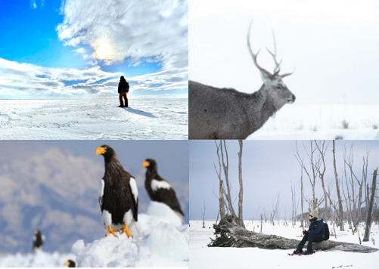
Snowshoe & Nature Cruise in Nemuro with AT Guide
The salmon caught in the Nemuro Strait has supported the livelihoods of coastal residents. During times of salmon scarcity, they shifted to scallop or kelp fishing, and as inland development progressed with the railway, dairy farming became popular.
They adapted their way of life flexibly according to the times, thriving in the harsh wilderness. This tour offers a chance to relive the history of human activities dating back ten thousand years, including encounters and exchanges between different cultures, as well as industrial development, helping participants understand the story of the Nemuro Strait coastal area.
6 Days Itinerary
Day 1: Meet the group in Nemuro Nakashibetsu Airport ( D)
Day 2: Snowshoe (around 2 hours) in Ruins Forest Shibetsu (B, L, D)
Day 3: Drift ice bird cruise (around 3 hours) in Rausu(B, L, D)
Day 4: Narawara Primeval Forest Snowshoe (around 3 hours )(B, L, D)
Day 5: Lake Furen ice fishing(B, L, D)
Day 6: White moans snowshoe hiking (B, L)
Remarks: B –Breakfast; L –Lunch; D –Dinner Meals as mentioned in the itinerary
(B = Breakfast, L = Lunch, D = Dinner)

Slide 2
Snowshoe & Nature Cruise in Nemuro with AT Guide
Highlights:
The salmon industry and the way of life of the Ainu people along the coast of the Nemuro Strait
The transition of industries such as scallops, kelp, Hokkai shrimp, and the development of inland areas including dairy farming
Activity to understand the history and major industries (Snowshoe hiking)
Chie Moue accompanies as a certified Adventure Travel Guide recognized in Hokkaido (Through guide)
Location:
The Nemuro Peninsula
The Nemuro Peninsula is a peninsula which extends from the east coast of Hokkaidō, Japan. It is some 30 kilometres (19 mi) long and 8 kilometres (5.0 mi) wide, and forms part of Nemuro City. Cape Nosappu at its tip is the easternmost point of Hokkaidō. The northern coastline is on Nemuro Bay, while the south faces the Pacific Ocean.
Main Activity:
Snowshoe
Difficulty:
2
Tour Dates:
January – March
Pax:
Minimum: 6
Maximum: 8
Route map
Day-by-day Itinerary
What’s included
We provide & What to bring
About us
Information and Requirements
Disclaimer

Slide 3
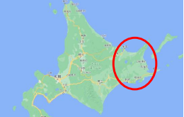
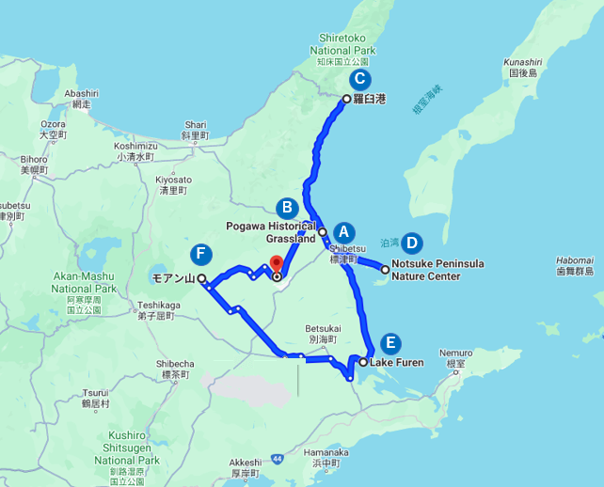
Snowshoe & Nature Cruise in Nemuro with AT Guide
Route map

Slide 4
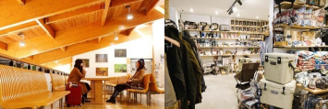
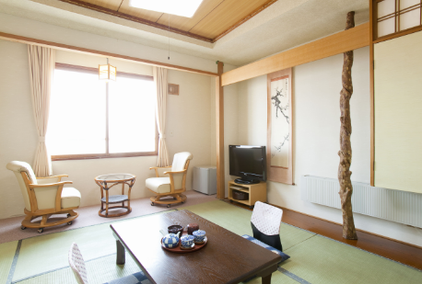
Snowshoe & Nature Cruise in Nemuro with AT Guide
Day-by-day Itinerary
Day 1 -Arrive at Nemuro Nakashibetsu Airport, Welcome Party
Welcome to Hokkaido! Travelers will be greeted by our tour guide at Nemuro Nakashibetsu Airport (2:00pm) we warmly greet you and start the journey.
After a 10-minute drive from the airport, you will see the viewpoint "Kaiyodai" on top of a small hill. Here we will get an overview of the field we will be visiting today. After that, we will drive about 15 minutes and stop at UB Coffee, an outdoor café in the city center.
There is also an outdoor store where we can buy or rent any gear we may be lacking. For dinner, we will go to a popular restaurant in Nakashibetsu that uses local ingredients. After a 30-minute drive, we will stay at an onsen ryokan in Shibetsu.
Dinner
Cheese dish of Nakashibetsu dishes with local ingredients at local izakaya
After dinner, stroll back to the hotel Kawabata at 8:30 pm.
Activity: -
Meals provided: Dinner
Accommodation: SHIBETSU River Hot Spring Hall of PURUKE Hotel KAWABATA

Slide 5
Snowshoe & Nature Cruise in Nemuro with AT Guide
Day-by-day Itinerary
Day 2 – Experience Snowshoe
The second day of the trip begins in earnest with an introduction to the "Salmon Sanctuary .Enjoy a breakfast buffet served at the hotel and leave the hotel at 08:30 am. Then, we enjoy a 2-hour river Snowshoe in Po River forest .
After a 10-minute drive from the hotel to the Po River Historic Park for guidance, we will head out into the vast field before us for a forest walk and canoeing tour.
Lunch
The lunch on this day you will enjoy chazuke, a traditional preserved food made from salmon in the mountains, with a dashi broth that you can blend yourself. The Rausu kelp and scallops used in the broth are major marine products from the Nemuro Straits.
After lunch, we will take a walking tour of the town to learn what the town looks like today based on the salmon sanctuary and history we learned at the beginning of the tour. You will have the opportunity to compare it with existing documents and screen paintings to learn how the region has developed.
Dinner
For dinner tonight, salmon dishes with local ingredients will be served. After the delicious dinner, we return to the hotel to spend the night.
Activity: Snowshoe in Po River forest
Activity details: Difficulty:2/5 Easy active
Time required: approx. 2hr
Meals provided: Breakfast,Lunch, Dinner
Accommodation: Hotel Minenoyu

Slide 6
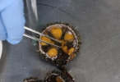
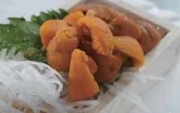
Snowshoe & Nature Cruise in Nemuro with AT Guide
Day-by-day Itinerary
Day 3 - Exciting Drift ice bird cruise
Whole day enjoying the activity that starts from 9:00 am to evening. We have a Japanese style menu breakfast at the hotel, then start our Shiretoko-Rausu Drift Ice Tour, Including Shrine, local maklet visit , drift ice observation
On the way back to town, we will stop by Hamada Shoten for lunch and try our hand at cracking sea urchins. To learn the fishing industry that developed in Rausu and the marine products that symbolize the richness of Shiretoko's seas while cracking sea urchins with an industrial guide and make a seafood bowl for lunch.
After returning to town and having lunch, it is time for a lecture by a veteran kelp fisherman. It will be touching the "Rausu kelp" that you tried in the previous day's ochazuke and learn about the source of the delicious taste that is carefully produced. Rausu kelp is a high-quality kelp that is attracting attention from all over the world. After being harvested, Rausu kelp undergoes 23 different processes and takes about 100 days to be made into a product.
After lunch, We will drive north along the coast of the Nemuro Straits for about an hour and enter Rausu, on the east coast of the World Natural Heritage Site Shiretoko.
Get on the Shiretoko Nature Cruise, the highlight of your wildlife experience. Join experienced crew in their search for Steller’s Sea Eagle and White-tailed Sea Eagle. It is said that Shiretoko Rausu is the only place in the world where you can see these birds in such a short time after boarding.
Experience firsthand the overwhelming sight and majesty of these wild animals, which are revered as gods (kamui) by the Ainu tribe, and the way of life of the people who have lived in harmony with the great outdoors
Dinner
For dinner tonight, seafood and sushi with local ingredients will be served.
Activity: Drift ice bird cruise
Activity details: Difficulty:1/5 Easy active
Time required: approx. 1.5hr
Meals provided: Breakfast,Lunch, Dinner
Accommodation: Hotel Minenoyu

Slide 7
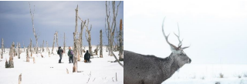
Snowshoe & Nature Cruise in Nemuro with AT Guide
Day-by-day Itinerary
Day 4 -Snowshoe in Primeval forest of Narawara
We start our day with a breakfast buffet served at the hotel and leave the hotel at 8:00 am.
Going to the Notsuke Peninsula area, a 60-minute drive south of Shiretoko. As with the Rausu kelp of the previous day, the area was developed through trial and error when the catch of major salmon declined, and fishing for scallops and Hokkai shrimp began, which led to the development of modern-day industries.
Take a snowshoe tour on the Notsuke Peninsula, which benefits from the rich waters of the Nemuro Straits. This is a premium activity that allows you to enter the primeval forest of Narawara on the Notsuke Peninsula under the limited guidance of a guide.
To learn about the rich marine resources of Notsuke Peninsula and observe wild animals such as Ezo sika deer
Dinner
Before heading out for dinner at local restaurant Shirao, we go back to our hotel at 3:00pm to take a short break. For dinner tonight, seafood from the Notsuke Peninsula with local ingredients will be served. After the delicious dinner, we return to the hotel to spend the night.
Activity: Snowshoe in Primeval forest of Narawara
Activity details: Difficulty:2/5 Easy active
Time required: approx. 3hr
Meals provided: Breakfast,Lunch, Dinner
Accommodation: Hotel Utageya

Slide 8
Snowshoe & Nature Cruise in Nemuro with AT Guide
Day-by-day Itinerary
Day 5 -Lake Furen Traditional fishing
We start our day with a breakfast buffet served at the hotel.
The main activity on the fifth day is a hands-on tour of Traditional fishing method in the Furen Lake with active fishermen. Lecture from an active fisherman in Nemuro and experience the traditional fishing method of ice net fishing under the ice at Lake Furen and learn about the harsh environment of fishing and unique Hokkaido fish such as those found under the ice.
Lunch
Today’s food is made with local ingredients, and you will have “Hanasaki Crab Ramen” for lunch at Suwan 44 Nemuro
After lunch , please enjoy free time at Nemuro!
Recommendation:
Experience dairy farming at Ito Ranch in Meigo, take a short break at the dairy cafe "Grassy Hill," and enjoy a cup of coffee at the Nakashibetsu Dairy Farm. Also take a short rest at Grassy Hill, a dairy café, or stop off at a local market in Nakashibetsu.
For dinner, we will have a Japanese-style dinner at “Yujyuku Daiichi”, with the richness of the local food from the mountains and the sea and try your hand at sake . Please enjoy hot spring and relaxing after a long day of travel.
Activity: Lake Furen Traditional fishing
Activity details: Difficulty:1/5 Easy active
Time required: approx. 2hr
Meals provided: Breakfast,Lunch, Dinner
Accommodation: Yuyado Daiich

Slide 9
Snowshoe & Nature Cruise in Nemuro with AT Guide
Day-by-day Itinerary
Day 6 -Snow shoe in Mt. Moan
Please enjoy the local dairy products of Shiretoko Nemuro area.
Those who wake up early in the morning can join a sunrise tour of the landmark Kaiyodai. In the morning, we will enjoy snowshoe trekking at Moan Mountain, where you can experience firsthand the history of dairy farming and pioneering.
The last activity will be completed with a remembrance of the feats of our forefathers who pioneered the vast land that feels so tremendous.
After a meal of local wheat bread and hot soup, we will head to the airport. We hope that you enjoy the trip and we would be delighted to see you again.
Activity: Snow shoe in Mt. Moan
Activity details: Difficulty:2/5 Easy active
Time required: approx. 3hr
Meals provided: Breakfast,Lunch
Accommodation: -
Accommodation information:
Nights 1:SHIBETSU River Hot Spring Hall of PURUKE Hotel KAWABATA
Nights 2: Hotel Minenoyu
Nights 3: Hotel Minenoyu
Nights 4: Hotel Utageya
Nights 5: Yuyado Daiich

Slide 10
Snowshoe & Nature Cruise in Nemuro with AT Guide
What’s included
Well-experienced activity guides
Necessary equipment for Wildlife observation
Meals included in the itinerary
Transports included in the itinerary
3 nights accommodation as outlined in the itinerary
What’s not included
Costs of a Personal purchases
Alcohol
We provide & What to bring
We provide
Snowshoe
Life jacket
What to bring
Earth-colored clothing and sneakers that are okay to get dirty or wet
Winter clothing
Waterproof shoes or boots
Hat
Gloves
To protect the animals, please wear earth-colored clothing and do not use umbrellas
Recommended or Optional items:
Personal first aid kit
Sunscreen

Slide 11
Snowshoe & Nature Cruise in Nemuro with AT Guide
About us
ANA X Inc. handle ticket sales and travel business operations for the ANA Group. Our mission is to provide a high quality of service and products and to deliver the most satisfying travel experience.
The Leisure Travel Business Division develops and markets original tour products. We are committed to fulfilling the expectations of our customers and offering unique and attractive and original tour products.
ANA has been highly commended [by SKYTRAX] for its consistently superior quality of service and for its dedication towards the further improvement of the overall passenger experience to meet the growing needs of global customers. Furthermore, ANA is currently the only Japanese airline to have achieved the exclusive 5-star status for 8 consecutive years.
Using the ANA Group motto “Trustworthy, Heartwarming, Energetic!” as the foundation of our operations, we will continue to treat our customers sincerely and provide safe travel products with high added value, while further improving our services through the united efforts of all of our employees.
Guides
Through guide
Chie Moue
・Interpreter Guide
・Forest Instructor
・Hokkaido Adventure Travel Guide

Slide 12
Snowshoe & Nature Cruise in Nemuro with AT Guide
Information and Requirements
Dietary Restrictions
Please inform us of any food allergies or special dietary requirements and we will be happy to accommodate you. However, there is no guarantee that we will be able to accommodate all food in tolerances or special diets.
Emergency Response Plan
First-aid kit is always be prepared during the tour. Adventure guides and activity guides are certified Hokkaido Certified Outdoor Guide or have completed Certificate of Advanced First Aid Course. They have sufficient skills and knowledge in first aid. Also, our East Hokkaido Branch of our company is located near activity spots, so our staff can provide appropriate assistance in an emergency.
Hospitals near activities spots are as follows.
• Kushiro : Kushiro City General Hospital, about 40-minute drive away.
• Nemuro : Nemuro City Hospital, about 30-minute drive away.
Weather Conditions
In Nemuro, the summers are cool and wet, the winters are freezing and snowy, and it is windy and partly cloudy year round. Over the course of the year, the temperature typically varies from -7℃ to 18 ℃ F and is rarely below -12℃ F or above 21 ℃
 | JAN | FEB | MAR
Average temperature (°C) | -2 | -3 | -0.5
Average low temperature (°C) | -6 | -6 | -2.7
Average high temperature (°C) | 0.5 | -0 | 1.6

Slide 13
Snowshoe & Nature Cruise in Nemuro with AT Guide
Reservation & Cancellation Policy
Payment Methods
Once booking is confirmed, we will inform you the payment procedure by email. You can settle the payment by credit card (“Visa” or “Master”).
Cancellation
Cancellation date | Cancellation charge
21 or more days prior to the starting day of the tour | Free
20 to 8 days prior to the starting day of the tour | 20% of the Tour Fare
7 to 2 days prior to the starting day of the tour | 30% of the Tour Fare
1 day prior to the starting day of the tour | 40% of the Tour Fare
On the date of departure | 50% of the Tour Fare
Cancelled after the start of the tour Failure to show without notice | 100% of the Tour Fare
*Refund process may take up to 1 to 2 months depending on when the refund request is received, and the closing date and refund processing procedure conditions of the applicable credit card company. It will be credited to your credit card when the time you purchased the package.

Slide 14
Snowshoe & Nature Cruise in Nemuro with AT Guide
Reservation & Cancellation Policy
Disclaimer
ANA X reserves the right to change these guidelines and disclaimers at any time.
• You specifically acknowledge that ANA X is not liable for defamatory, offensive, infringing or illegal materials of any third party, and ANA X reserves the right to remove such materials without liability.
• In performing its obligations under the terms of its tour contract, should ANA X cause damage to the customer through willful negligence or fault, ANA X shall be liable for such damages. However, this only applies if the damage report is made within 2 years reckoned from the day following the occurrence of the damage.
• ANA X should not be liable for damages incurred by customers as stipulated above if any of the following reasons applies.
1. Nature disaster, war, civil unrest, and alteration or cancellation of tour itinerary due to such causes.
2. Cessation of services related to transportation or accommodation facilities, and tour itinerary alteration or cancellation owing to such causes.
3. Governmental orders, or isolation resulting from infectious diseases.
4. Accidents occurring during free time.
5. Food poisoning.
6. Theft.
7. Delays, stoppages, changes of schedule and route in relation to transportation facilities, and tour itinerary alterations and/or shortened stays at destinations owing to such causes.
8. Any matter beyond ANA X’s (or its licensees’ or licensors’) reasonable control. Even if such party has been advised of the possibility of such.
• Please be aware that you may encounter risks in the activities included in this tour. We do not guarantee that there will be no accidents on the tour. You must follow the attention and instructions of each guide. We reserve the right to terminate the travel contract if you cause a disturbance to other guests or interfere with the smooth conduct of group activities.
Tour Operator / Contact
ANA X Inc.
Address :Front Place Nihonbashi, 2-14-1, Nihonbashi, Tokyo 103-0027, Japan
Contact: inb03@ana-x.co.jp
Partner Companies
Shiretoko Nemuro Tourisum Federation
Contact: info@ekari.jp

