Slide 1
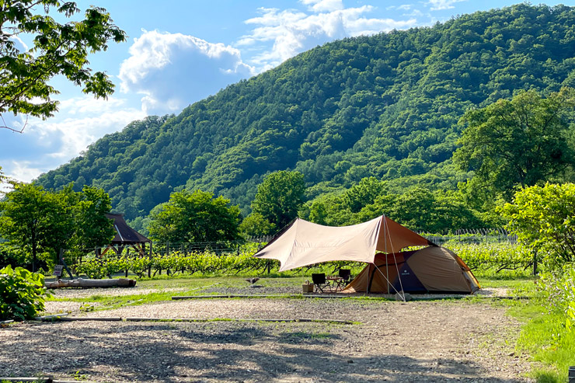
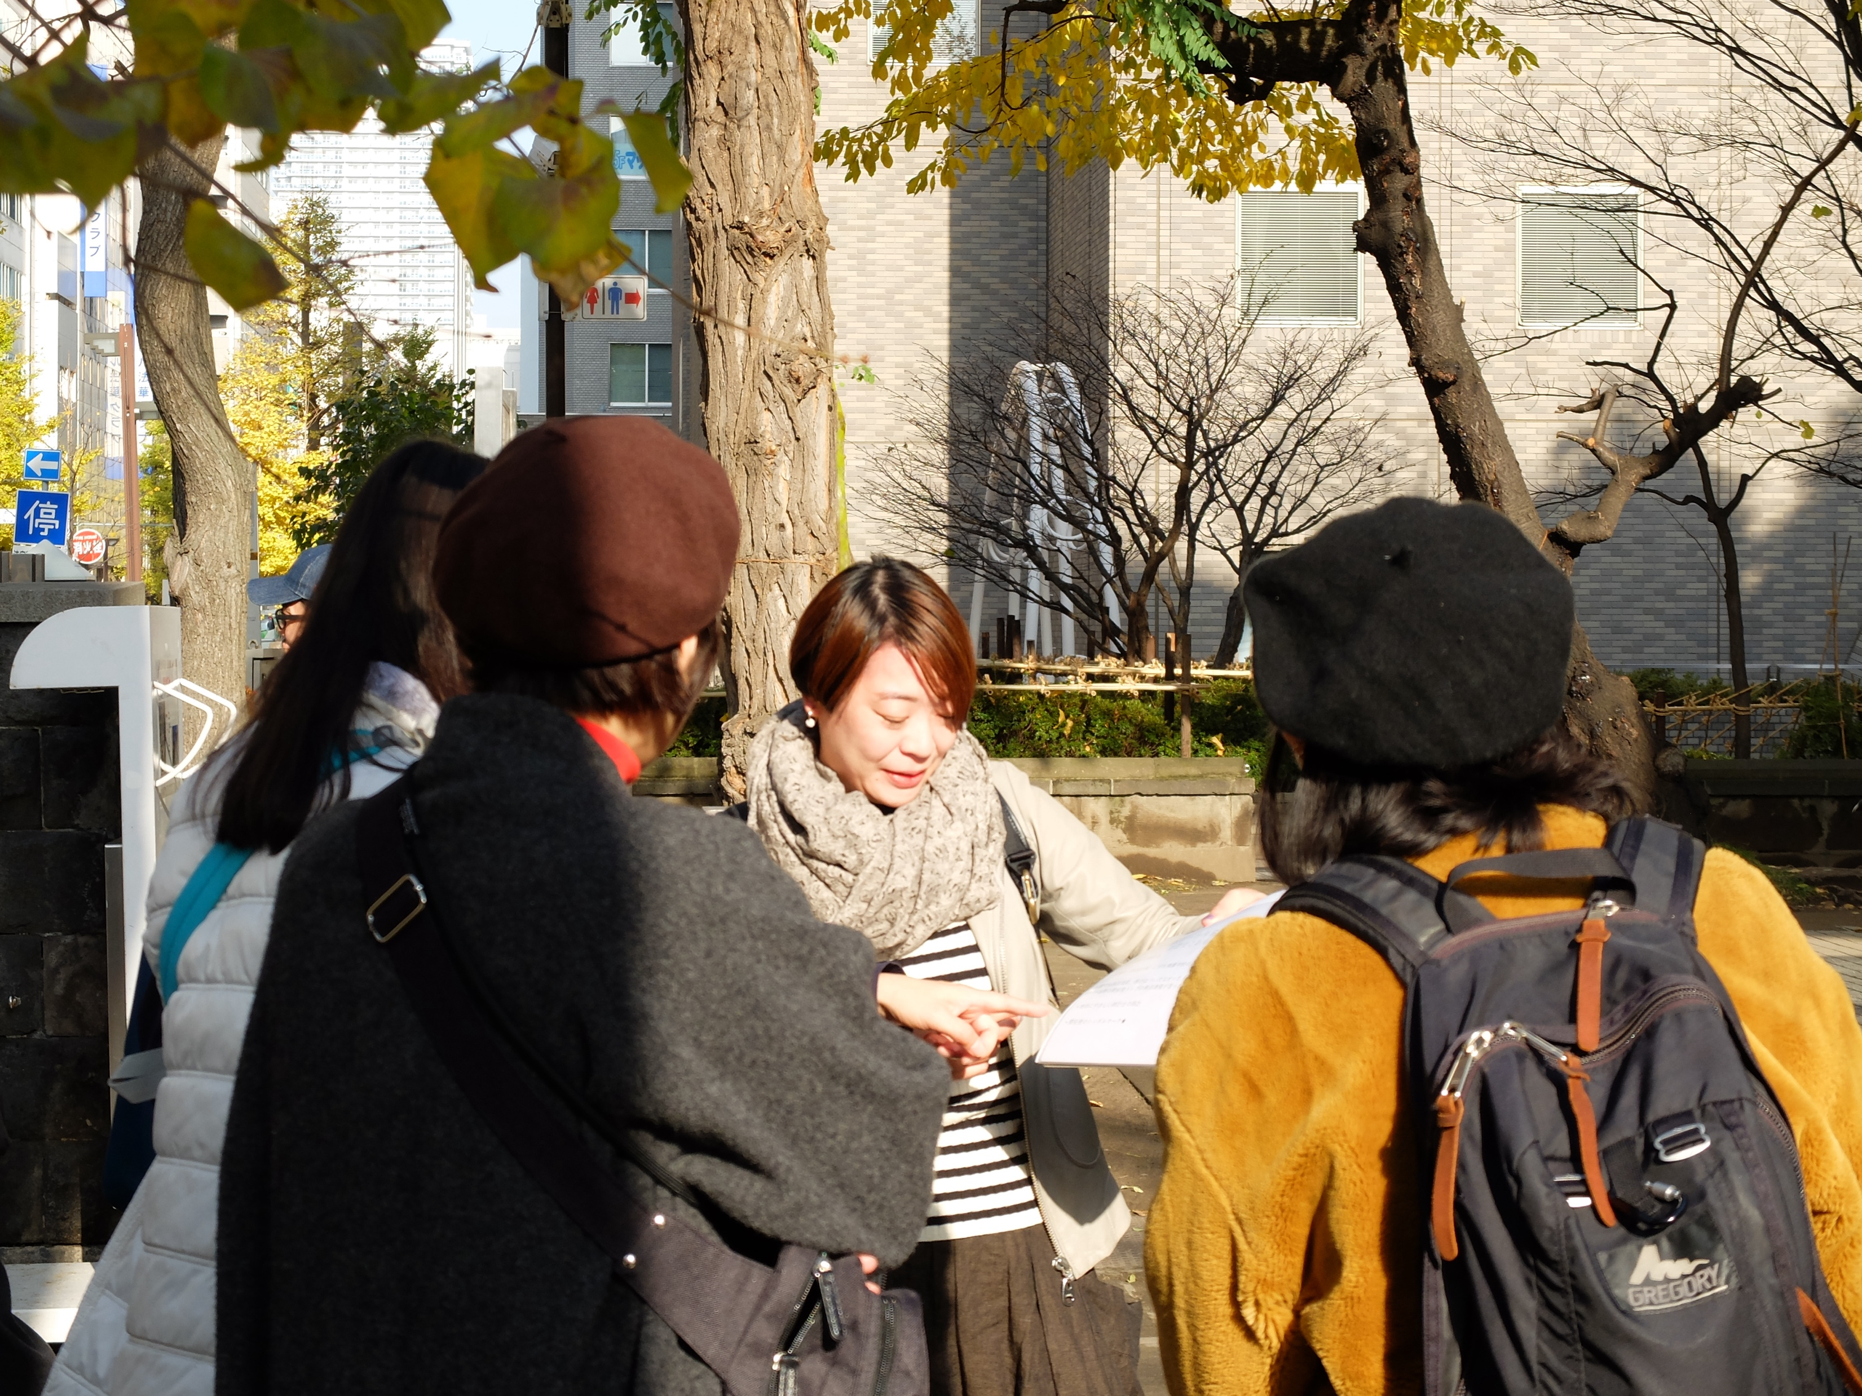
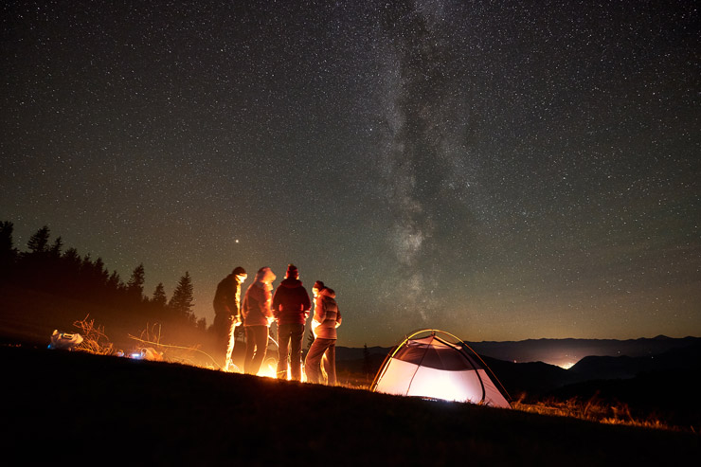
Local Sake Crawl by Hiking and Camping
In Sapporo
ツアータイトル
シンプルでかつ具体的に書く。最大55文字。メインアクティビティと場所を示すのが理想。
イメージ写真
PSA 4枚程度（解像度は問わない）
Sapporo's unique charm of being close to both a modern city and nature is a rare balance that is rarely found anywhere else in the world. This tour is an urban adventure in which you will directly experience the activities of the people who live in this land and its charms through camping and hiking. We will enjoy the diverse sake culture under the theme of "local sake," which is one of the elements that indicate the uniqueness of a certain region. The tour will take you from the city center to Jozankei, a hot spring resort town loved by local residents and called "the backwaters of Sapporo.
ストーリー
（150語まで。最大2,000文字）
ツアーのストーリー、特別な点は何なのかを伝える。高い次元の話で、宿泊、交通、食事といった旅行の構成要素の話ではない。

Slide 2
Local Sake Crawl by Hiking and Camping In Sapporo
ツアータイトル
Highlights:
Enjoy Sapporo's iconic "CraftGin9148" in a natural setting near the city
Enjoy local wine and bonfire under the lush greenery and starry sky
Enjoy the view from Hakkenzan, a rocky peak, looking back on the path you have hiked up to that point.
ツアーのハイライト
ハイライト3～5点の箇条書き。
1点につきスペースを含めて80文字以下
ツアーの何が面白いのか参加者が一目で分かるようにする。
Location:
The tour passes through beautiful nature from Sapporo Station to Jozankei. Departing from Sapporo Station, the first section of the route passes through the city of Sapporo. After passing through the city, the scenery changes drastically, gradually moving into the suburbs and then into the mountainous area. The vast forests and majestic mountains of Sapporo, Hokkaido, can be seen, especially in autumn and winter when the leaves turn red and the snowy landscape can be enjoyed. The tour continues to Jozankei, a hot spring resort located in the southwestern part of Sapporo, Hokkaido, which is well known among local residents as a nature-rich valley area.
実施場所について
ツアーが実施される都道府県、地域を明記する
メインアクティビティ
全体の難易度
ツアー期間
Main Activity:
Camping & Hiking
催行人員
Difficulty:
3
ツアー代金
8名基準、税込み
Tour Dates:
3 days and 2 nights from April to October
Pax:
Minimum 2
Maximum 8
Price:
JPY90,000
Route map
各ページへのハイパーリンクを付けています
Day-by-day Itinerary
What’s included
We provide & What to bring
About us
Information and Requirements
Reservation & Cancellation policy

Slide 3
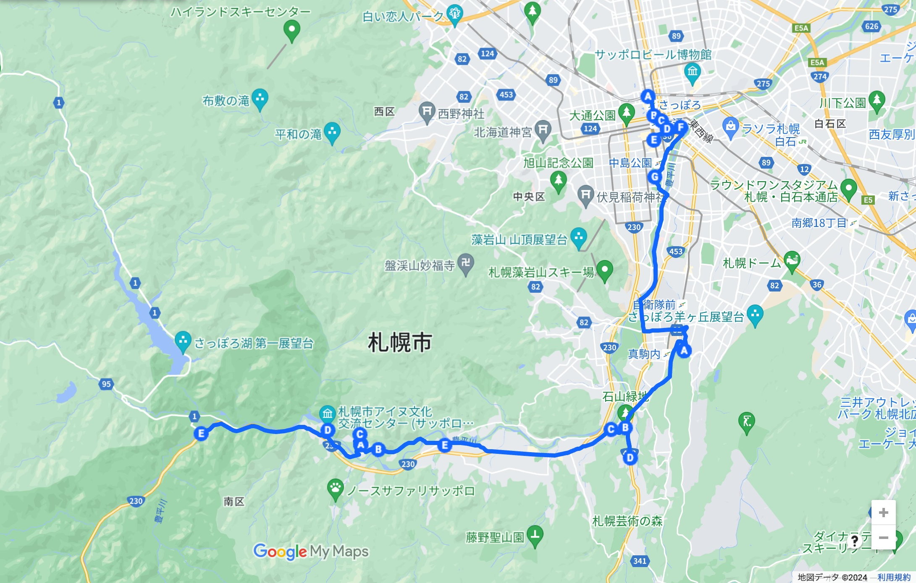
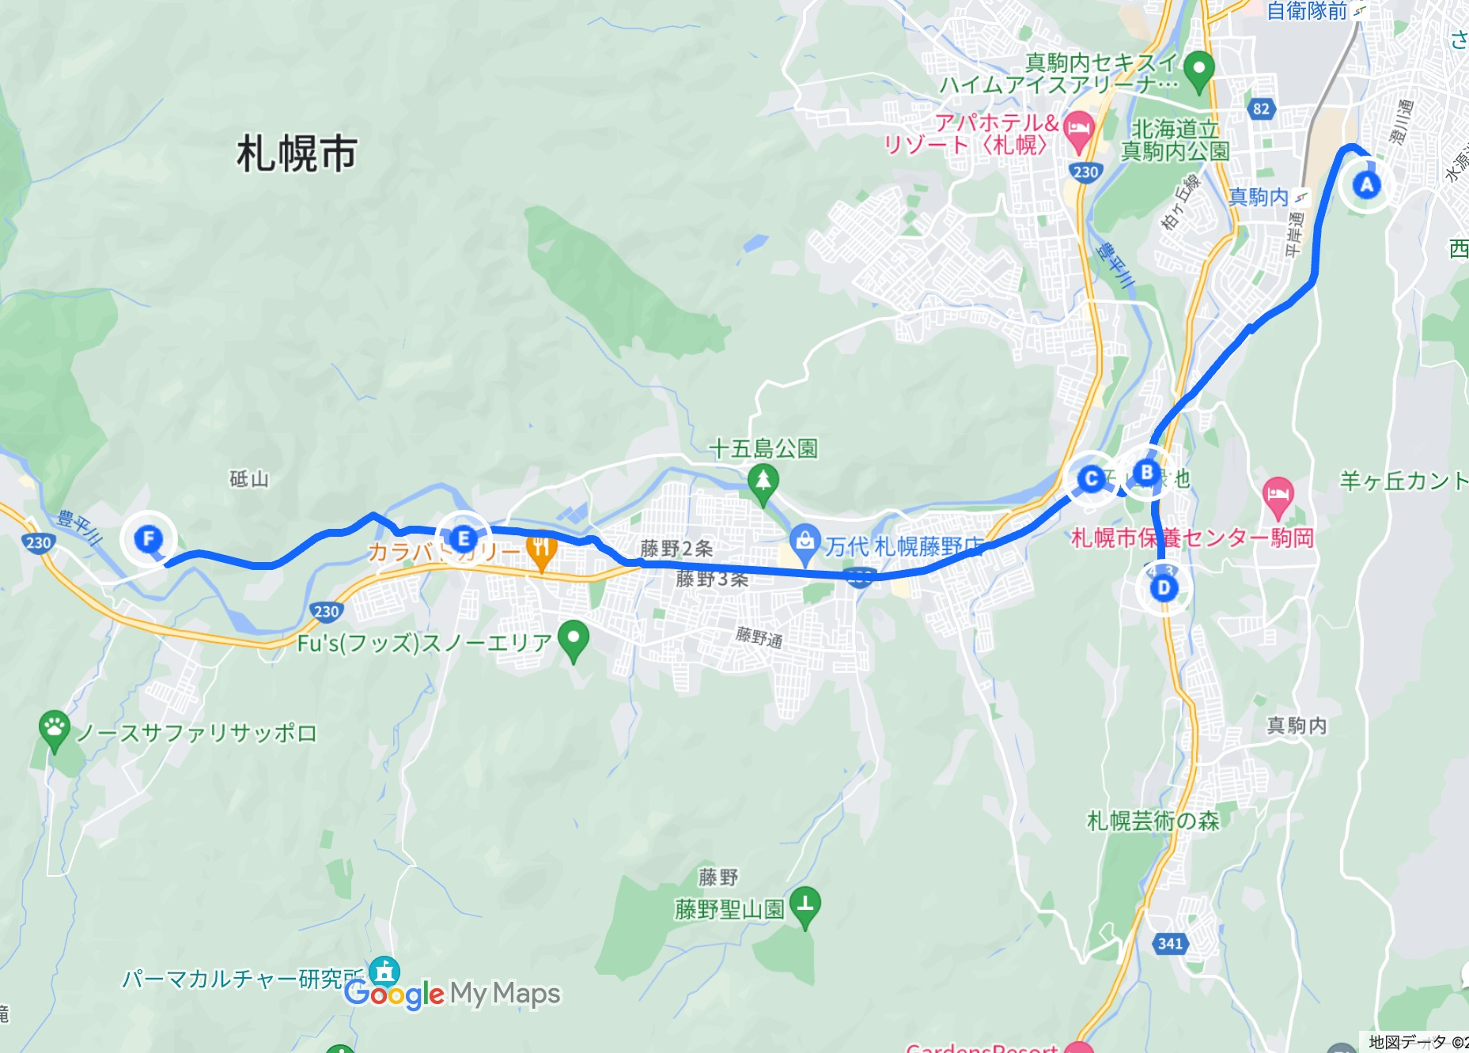
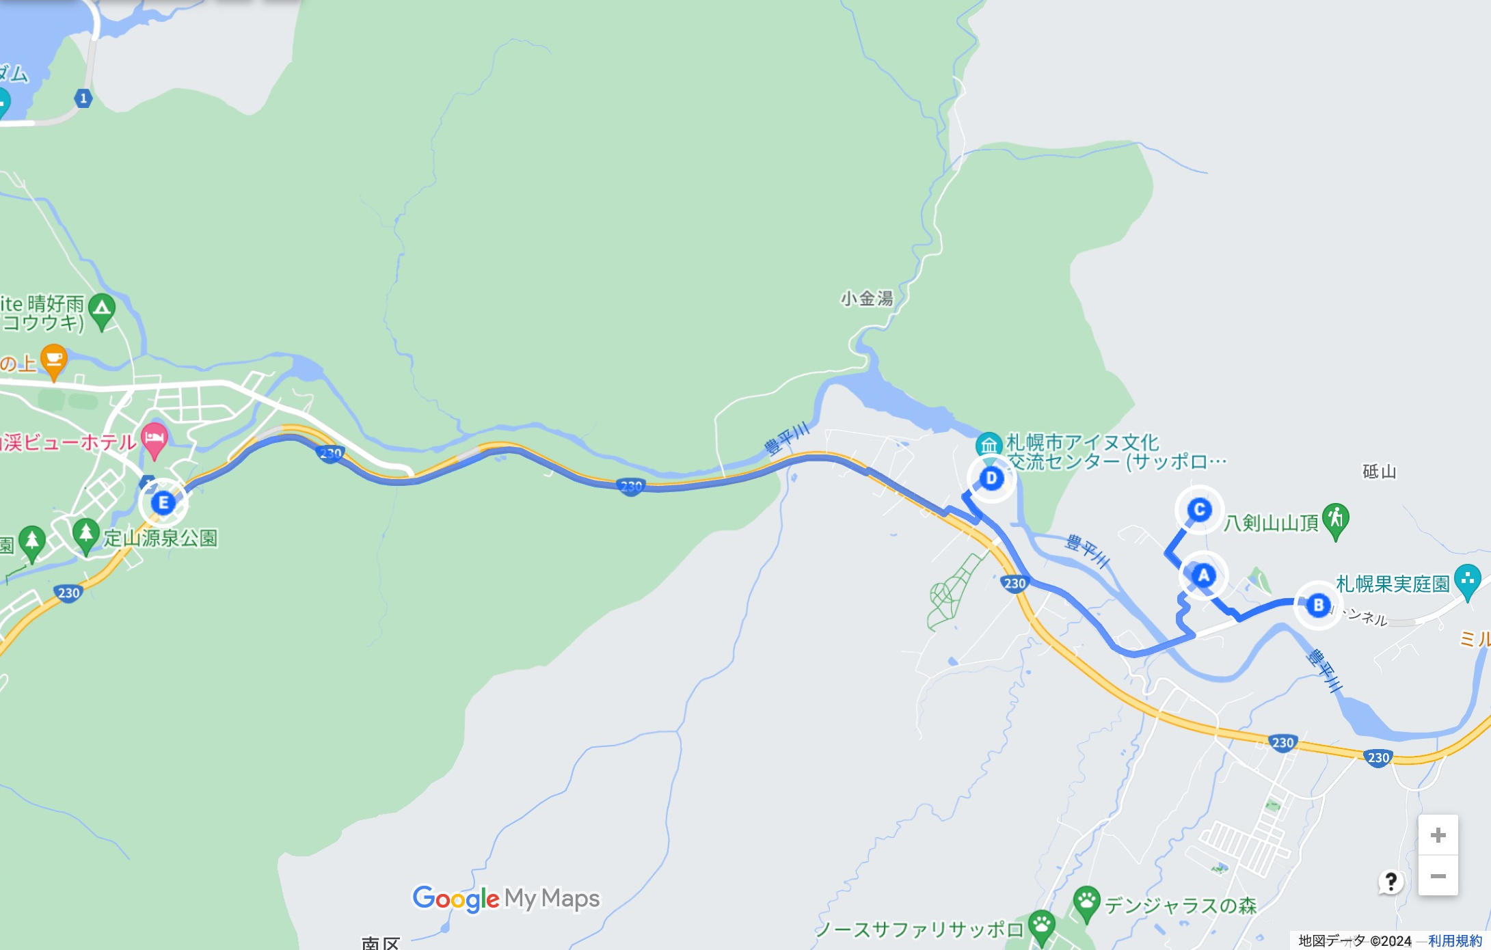
Local Sake Crawl by Hiking and Camping In Sapporo
Route map
行程を示す地図
添付の例は、Google Mapの「マイマップ」機能利用
Tour starts from
Sapporo Sta., Sapporo
Tour ends
in Jozankei, Sapporo
DAY 1
DAY 2
DAY 3

Slide 4
Local Sake Crawl by Hiking and Camping In Sapporo
Day 1 - Hiking along the Toyohira River in central Sapporo
Enjoy "Susukino Eru," a craft beer from Susukino, at the "Susukino Eru Stand" in the new tourist spot "COCONO SUSUKINO".
Lunch
We will have excellent nigiri at Takee Sushi, a famous restaurant loved by local customers at the popular tourist spot Nijo Market.
The tour will also include a visit to Chitose Tsuru, Sapporo's only sake brewery established in 1872, to taste sake rooted in this region and to experience the Toyohira River and Hokkaido's sake rice.
Enjoy urban camping in the " Benizakura Outdoor Garden" where you can enjoy rich nature while being adjacent to the city.
Dinner
We will enjoy BBQ and "Benizakura Distillery Craft Gin" at Kohsakura Outdoor Garden.
Activity:
Hiking and Camping
Difficulty:
3

Slide 5
Local Sake Crawl by Hiking and Camping In Sapporo
Day 2 - Hiking in the Ishiyama area of Minami-ku
Breakfast
We will have deli at the campground.
Visitors will experience the distance between the city and the forest at the Sapporo Sumikawa Urban Environmental Forest, a publicly owned private forest.
Lunch
We will enjoy lunch at the cafe "Post-Kan (former Ishiyama Post Office)" which is a historical building made of Sapporo soft stone.
In Ishiyama Ryokuchi, where visitors can enjoy the unique scenery, they can experience the relationship with Sapporo soft stone and appreciate the beauty of the rock formations and artworks that harmonize with the surroundings. For a snack, try the special sake gelato at Gelato Sapporo Karinju.
Dinner
You can enjoy a meal at Hakkenzan Kitchen & Marche and local wine made from grapes and apples produced by the company and neighboring farmers.
Activity:
Hiking and Camping
Difficulty:
3

Slide 6
Local Sake Crawl by Hiking and Camping In Sapporo
Day 3 - Climbing Hakkenzan and hiking in Jozankei area
Breakfast
We will have deli at the campground.
Hakkenzan is a low mountain with a unique shape and thrilling climbing experience. From the summit, you can look back on the path you have taken so far and feel closer to Sapporo.
Lunch
We will have excellent bread at Ayungu, a cafe and stone oven bread store.
Koganeyu Onsen is a famous hot spring in Sapporo that relieves fatigue after three days of work. The hot spring, which is said to have gushed out from under a Katsura tree that is now estimated to be 700 years old, has long been loved by local residents as a cure for illness.
Activity:
Hiking and Camping
Difficulty:
3

Slide 7
Local Sake Crawl by Hiking and Camping In Sapporo
Accommodations :
DAY1: Benizakura Outdoor Garden（Camping）
DAY2 : Hakkenzan Winery Bonfire Campsite（Camping）
What’s included
2 nights nights camping at the campground
2 breakfasts, 3 lunches, 2 dinners
1 glass of craft beer, sake tasting, craft gin tasting, 1 bottle of wine
Entrance fees to facilities listed in the itinerary
Snacks and refreshments
English speaking Japanese guide(s)
Not included :
Airfares
Personal expenses
Additional alcoholic drinks with included meals
宿泊先の情報
宿泊の種別（ホテル、キャンプ、山小屋など）（分かれば名称も入れる）
部屋タイプ、バス・トイレなど
ツアー代金に含まれるもの

Slide 8
Local Sake Crawl by Hiking and Camping In Sapporo
We provide & What to bring
We provide
First aid kit
Safety equipment and maps
ツアーオペレーターが提供するもの
What to bring
Essentials
•Waterproof jacket and pants
•Hiking boots
•Fleece or down jacket (even in summer the temperature can drop below 10
•Thermal layers top & bottom
•Base layers top & bottom
•Spare pairs of socks
•Gloves, beanie, and other items to keep you warm
•Sun hat, sunscreen, and sunglasses
•Water bottle or hydration system of more than 2L
•Head torch
•Quick dry hand towel
•Personal medications
•Backpack with enough capacity to carry all the above
•Rain cover for backpack
•Travel insurance
•Passport
•Cash in Japanese yen
Recommended items
•Walking poles
•Cell phone power bank
•Dry bags
•Extra snacks which you’re used to eating while hiking
•Camera
参加者にご用意いただくもの

Slide 9
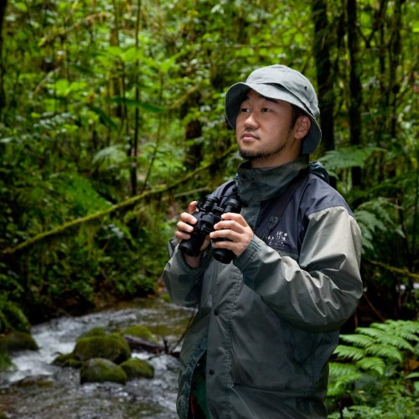
Local Sake Crawl by Hiking and Camping In Sapporo
About us
We are a Sapporo-based company that provides tour operations and tourism consulting. It was founded in 2020 to play a part in sustainable tourism in Hokkaido in the midst of the turmoil caused by COVID-19. In the post-COVID era, the tourism industry must make drastic changes, and it is necessary to flexibly respond to changing situations at unprecedented speeds. Like the sika deer, which is endemic to Hokkaido, we meet the expectations of our customers with strength and broadness of perspective.
Specifically, we provide clients with highly unique experiences, primarily in Hokkaido. We offer various outdoor activities tailored to fit client needs, such as guided backcountry skiing. For adventure travel, we provide comprehensive coordination. In collaboration with local research institutes and artists, we are also planning tours that convey the deep spirituality of Ainu culture.
このツアーを主催するオペレーターについての概要
スルーガイド、各アクティビティガイドについて、特徴・資格など
Guides
その他注意すべき点があれば記載する
In 2009, he opened the wine bar "Barcom Sapporo" as a place to connect producers and consumers. It also holds events to promote exchanges between producers (local) and consumers (food and agriculture education). Projects such as "Lunch in the Vineyard," which includes visits to slow food producers and wineries, are also popular.
The company is currently promoting the attractiveness of the region through inbound business from Europe, the U.S., and Asia. Guides a total of 400-500 people a year.

Slide 10
Local Sake Crawl by Hiking and Camping In Sapporo
Information and Requirements
Dietary Restrictions
• We will do our best to accommodate any special dietary requests from guests who
are vegetarians, or who have food allergies, etc.
食事に関する情報、アレルギー、ベジタリアンへの対応など
Emergency Response Plan
• In case of emergency, we will follow our accident response manual.
• The guide of this tour has completed an advanced first aid course and always carries a first aid kit with her.
• In the event of a disaster, we will follow "Initial Disaster Response Manual for Foreign Tourists" produced by the Hokkaido Tourism Organization.
緊急事態への対応など
社の体制、緊急対応計画書の有無、実践経験等を記載

Slide 11
Local Sake Crawl by Hiking and Camping In Sapporo
Reservation & Cancellation Policy
Payment Methods
We require a Deposit of 50 000 yen or Full Payment to secure your booking. The Depositis treated as a part of the Tour Price. You will receive an email reminder about payment of the balance, which is generally due 30 days prior to the tour departure date.
Credit cards (Visa / MasterCard) or PayPal are accepted.
支払方法
支払い方法の一覧を記載（クレジットカード、PayPalなどの電子決済システム、電信送金）
Cancellation
取消条件
If you wish to cancel a tour reservation, please notify us in writing Our Cancellation Policies as follows.
•Cancelled more than 21 days prior to departure Zero fees
•Cancelled between 20 and 8 days prior to departure 20 of the Tour Price
•Cancelled between 7 days and 48 hours prior to departure 30 of the Tour Price
•Cancelled between 48 and 24 hours prior to departure 40 of the Tour Price
•Cancelled within 24 hours of departure 50 of the Tour Price
•Cancelled on the day of departure 100 of the Tour Price
•No refunds will be given after the tour has commenced
免責事項
Disclaimer
• There are certain inherent risks in adventure travel. These include, but are not limited to, risks of cycling, hiking, swimming, walking and -on all trips- danger of animals, inaccessibility of medical attention and difficulty in evacuation in the case of a medical emergency. Passengers assume all such risks with regard to these possibilities. By embarking upon his/her trip, the traveler voluntarily assumes all risks involved in such travel, whether expected or unexpected.
• In addition and without limitation, Ezosika Travel Co., Ltd. is not responsible for any injury, loss, death, inconvenience, delay or damage to personal property in connection with the provision of any goods or services, whether resulting from but not limited to acts of God or force majeure, illness, disease, acts of war, civil unrest, insurrection or revolt, animals, strikes or other labor activities, criminal or terrorist activities of any kind, overbooking or downgrading of services, food poisoning, mechanical or other failure of aircraft or other means of transportation or for failure of any transportation mechanism to arrive or depart on time.
• Furthermore, Ezosika Travel Co., Ltd. cannot be held liable by freelance guides for damage or injury to the guide, or damage or injury inflicted by the guide on third parties in any way. By accepting freelance tour assignments, guides automatically waive Ezosika Travel Co., Ltd. from any liability.
協力事業者
ツアー催行者・連絡先

Slide 12
Local Sake Crawl by Hiking and Camping In Sapporo
Tour Operator / Contact
Corporate name : Ezosika Travel Co., Ltd.
Address of Head Office: Minami 1-jo Nishi 17-chome, Chuo-ku, Sapporo, Hokkaido, Japan
Licensed by the Hokkaido Government Office in accordance with the provisions of the Travel Agency Law.
Licence Number: No. 3-802
Date of License: 5 June 2020
Term of Validity: from 5 June 2020 to 4 June 2025
Domestic Travel Services Manager: NAKANE Hiroki
Email: support@ezosika.co.jp
WEB: https://www.ezosika.co.jp
支払方法
支払い方法の一覧を記載（クレジットカード、PayPalなどの電子決済システム、電信送金）
取消条件
免責事項
協力事業者
ツアー催行者・連絡先

